Slide 1
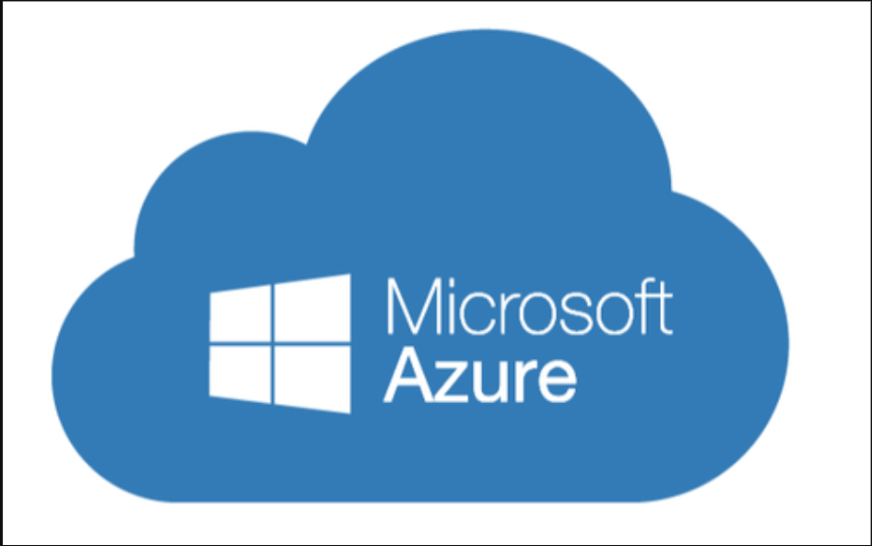

Slide 2
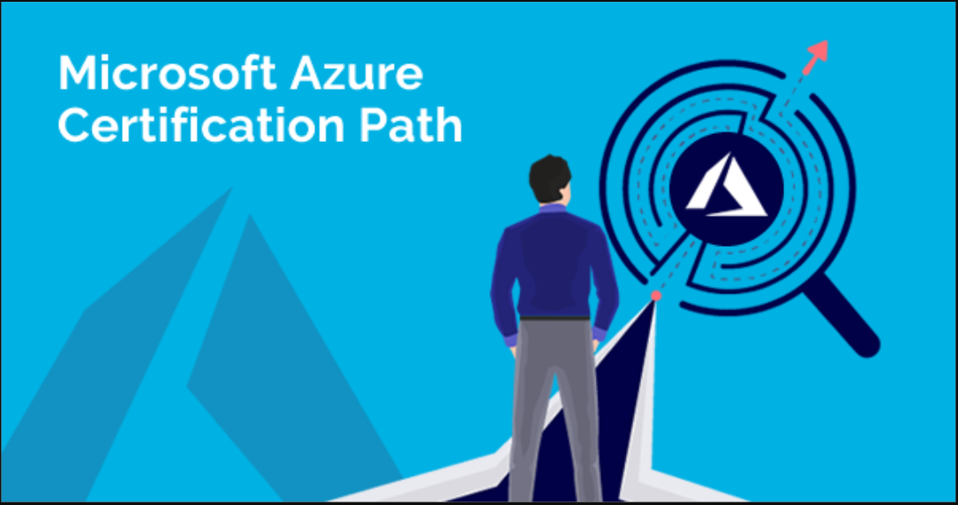

Slide 3
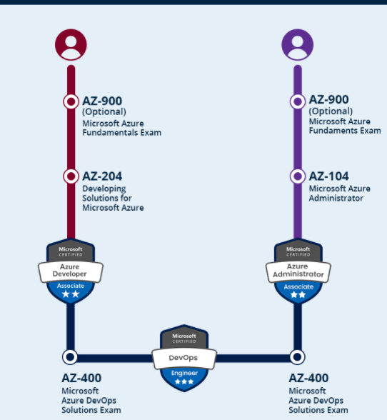

Slide 4
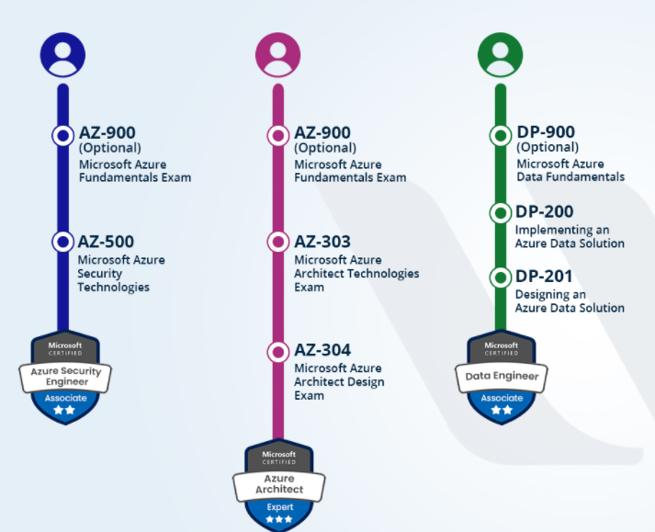

Slide 5
What is CLOUD?
What do we have in the CLOUD?

Slide 6
1. Infrastructure
2. Developer
3. Security
4. Data Analytics

Slide 7

CLOUD COMPUTING

Slide 8
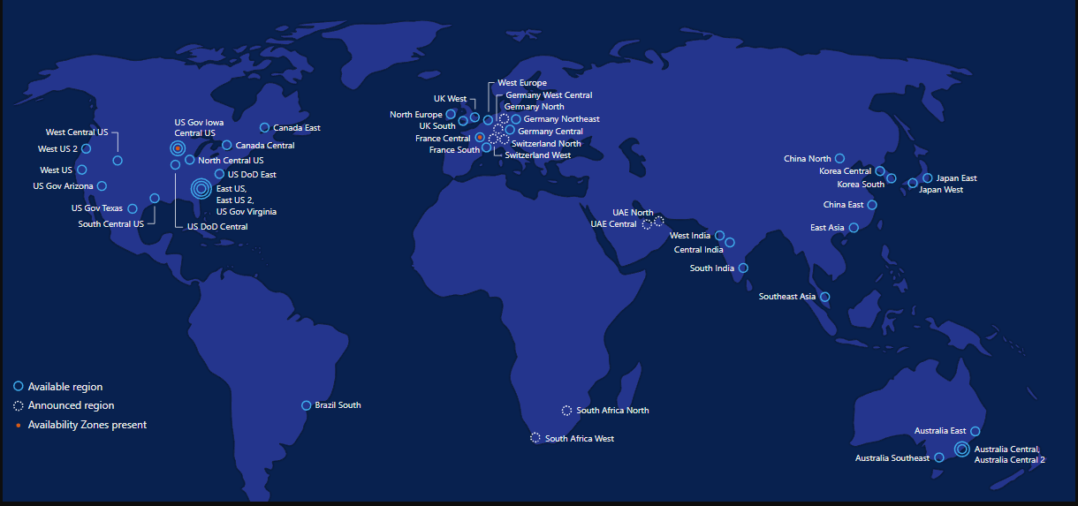

Slide 9
ADVANTAGES
1. COST EFFECTIVE
2. AGILITY
3.SOFTWARE INTEGRATION
4.UNLIMITED STORAGE

Slide 10
ADVANTAGES
5. SCALABILITY
6. GLOBAL ACCESS
7. AUTOMATED UPDATES
8. QUICK DEPLOYMENT
9.READY TO USE SERVICE

Slide 11
DISADVANTAGES
1. RECURRING COST
2. SECURITY
3. LACK OF CONTROL
4. VENDOR LOCKED IN
5. DOWNTIME

Slide 12

DATA CENTER

Slide 13


Slide 14
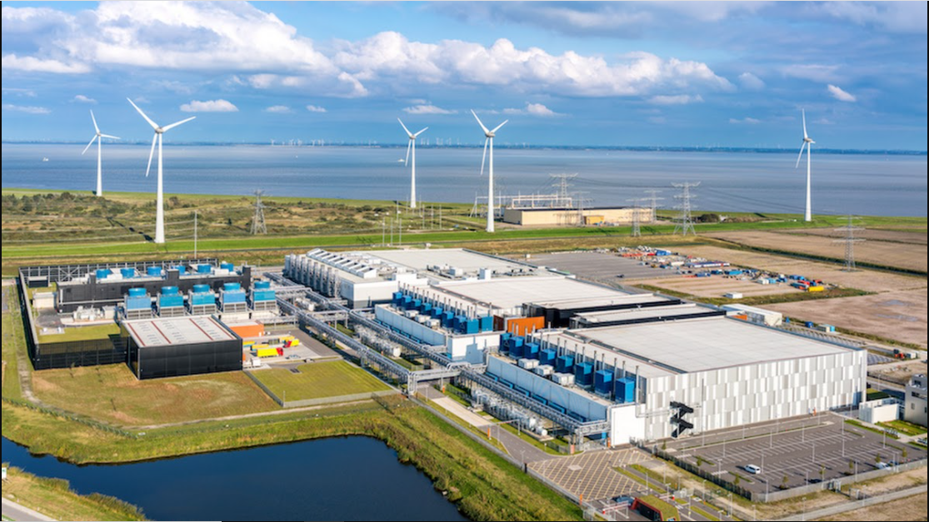

Slide 15
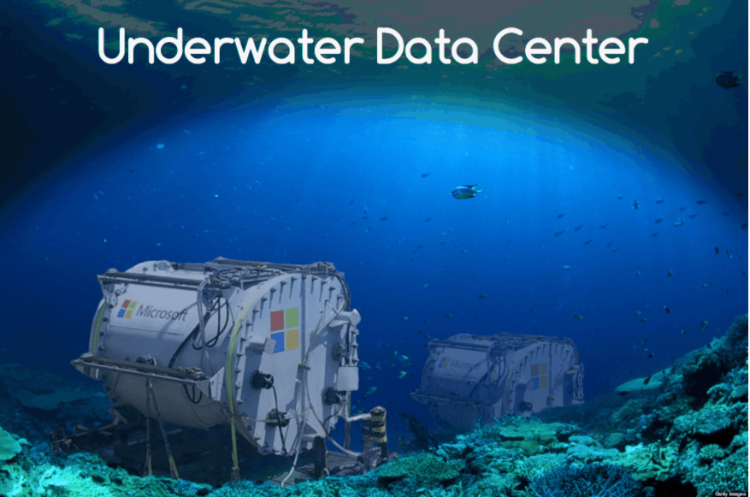
The underwater data center was designed with cooling systems and renewable electricity from on-shore wind and solar as well as off-shore tides and waves. Microsoft is on a journey to become carbon-negative by 2030 through advancing the efficiency and sustainability of its cloud infrastructure

Slide 16
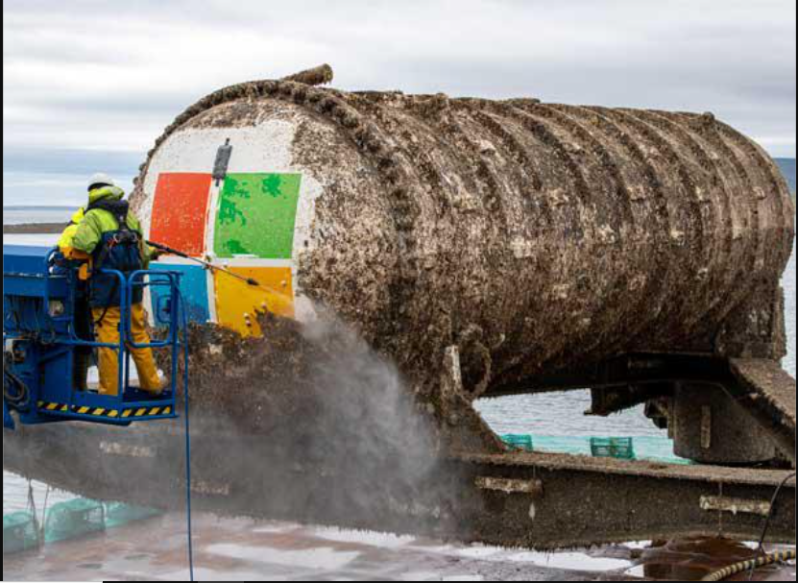

Slide 17
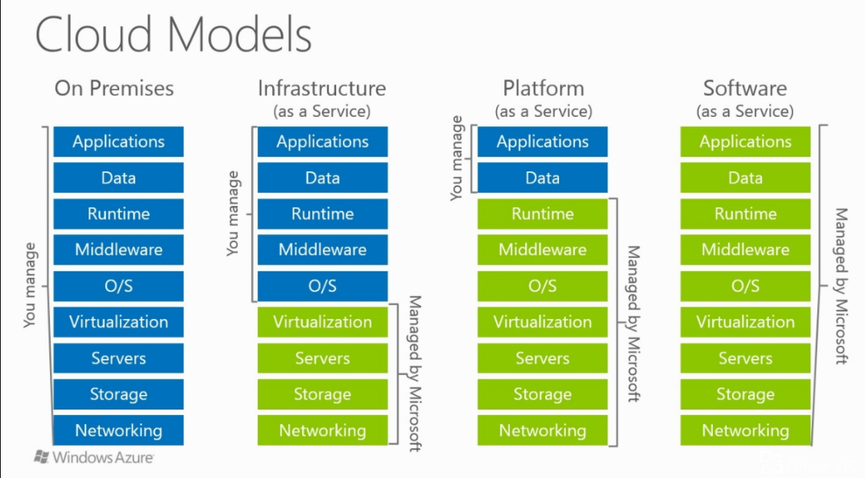

Slide 18
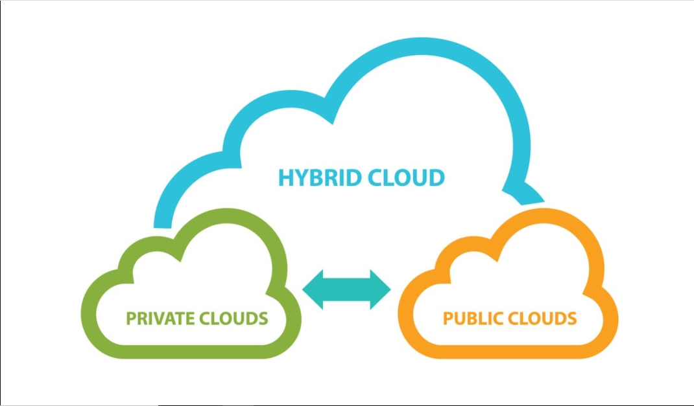
Types of Clouds

Slide 19
Redundancy
Azure Storage always stores multiple copies of your data so that it is protected from planned and unplanned events, including transient hardware failures, network or power outages, and massive natural disasters.
Redundancy ensures that your storage account meets its availability and durability targets even in the face of failures.

Slide 20
Types of Redundancy
Locally redundant storage (LRS) copies your data synchronously three times within a single physical location in the primary region. LRS is the least expensive replication option, but is not recommended for applications requiring high availability or durability.
if a disaster such as fire or flooding occurs within the data center, all replicas of a storage account using LRS may be lost or unrecoverable.

Slide 21
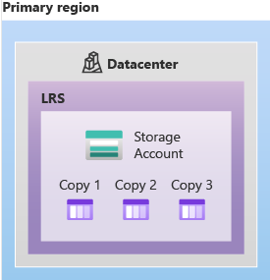
LRS recommended only If your application stores data that can be easily reconstructed if data loss occurs, you may opt for LRS.

Slide 22
Zone-redundant storage (ZRS) copies your data synchronously across three Azure availability zones in the primary region.
For applications requiring high availability, Microsoft recommends using ZRS in the primary region, and also replicating to a secondary region.
With ZRS, your data is still accessible for both read and write operations even if a zone becomes unavailable.
A write request to a storage account that is using ZRS happens synchronously. The write operation returns successfully only after the data is written to all replicas across the three availability zones.

Slide 23
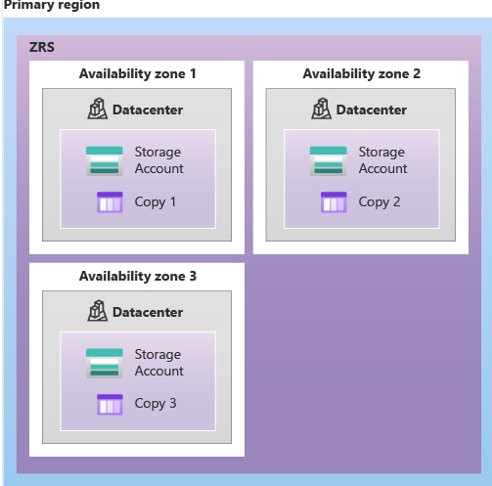
The following diagram shows how your data is replicated across availability zones in the primary region with ZRS:

Slide 24
Geo-redundant storage (GRS) copies your data synchronously three times within a single physical location in the primary region using LRS.
It then copies your data asynchronously to a single physical location in the secondary region. Within the secondary region, your data is copied synchronously three times using LRS.
A write operation is first committed to the primary location and replicated using LRS. The update is then replicated asynchronously to the secondary region. When data is written to the secondary location, it's also replicated within that location using LRS.

Slide 25
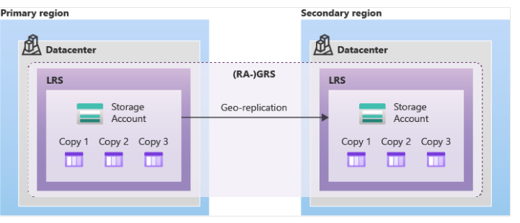

Slide 26
Geo-zone-redundant storage (GZRS) copies your data synchronously across three Azure availability zones in the primary region using ZRS.
It then copies your data asynchronously to a single physical location in the secondary region. Within the secondary region, your data is copied synchronously three times using LRS.

Slide 27
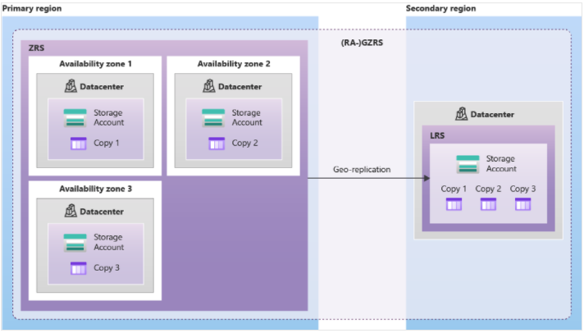

Slide 28
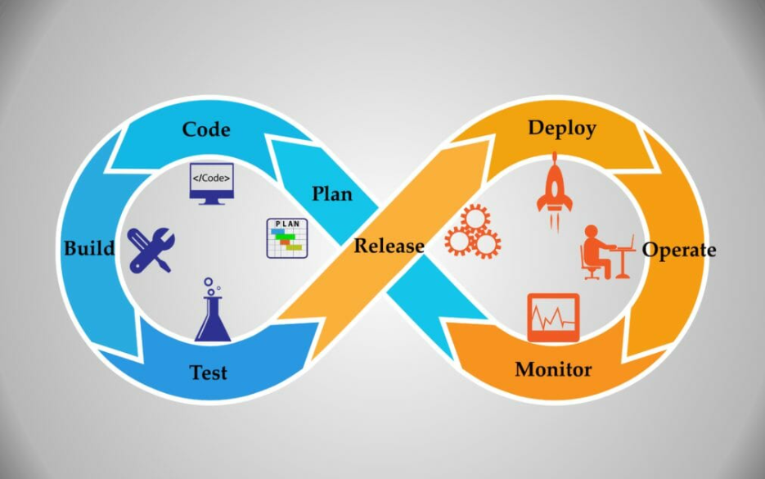

Slide 29
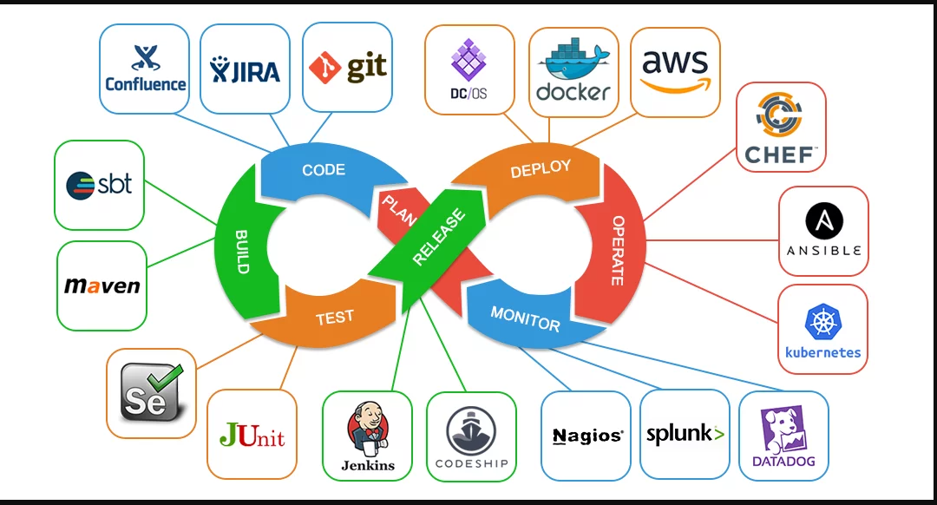

Slide 30
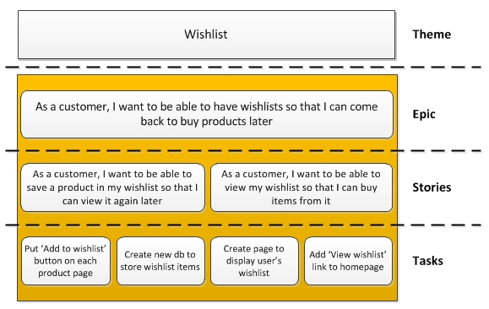
AZURE-BOARDS

Slide 31
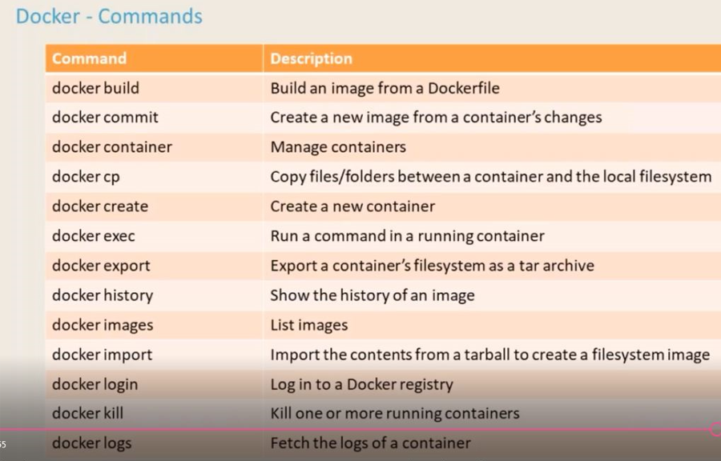
DOCKER COMMANDS

Slide 32
